Slide 1

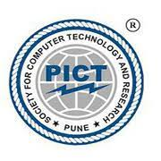

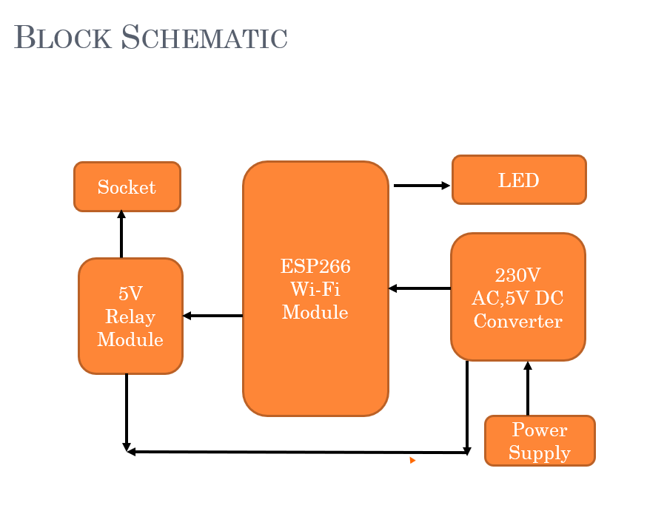

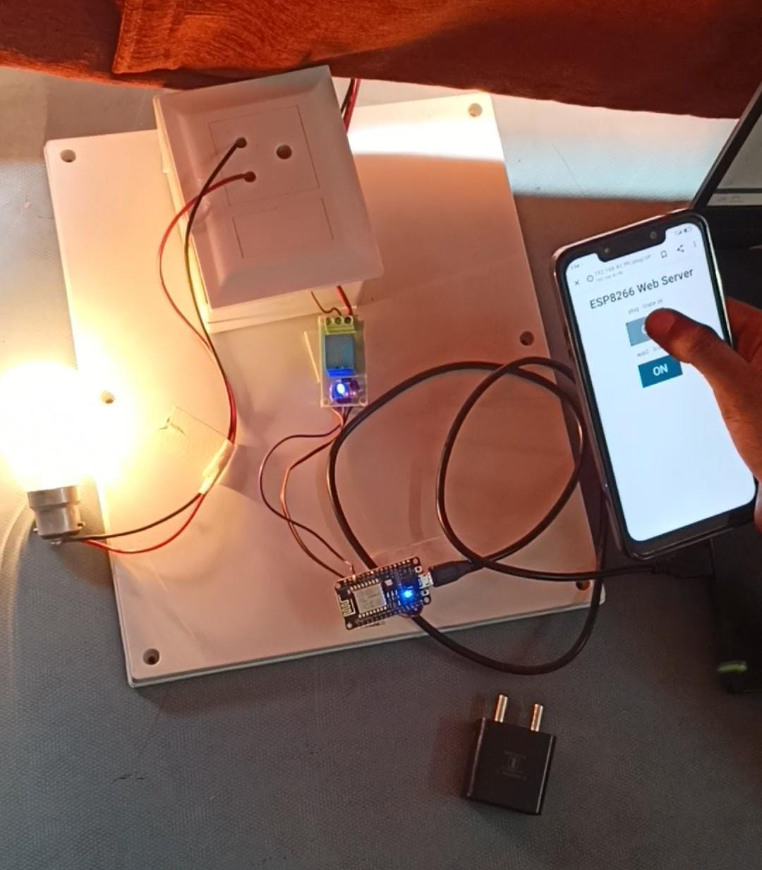
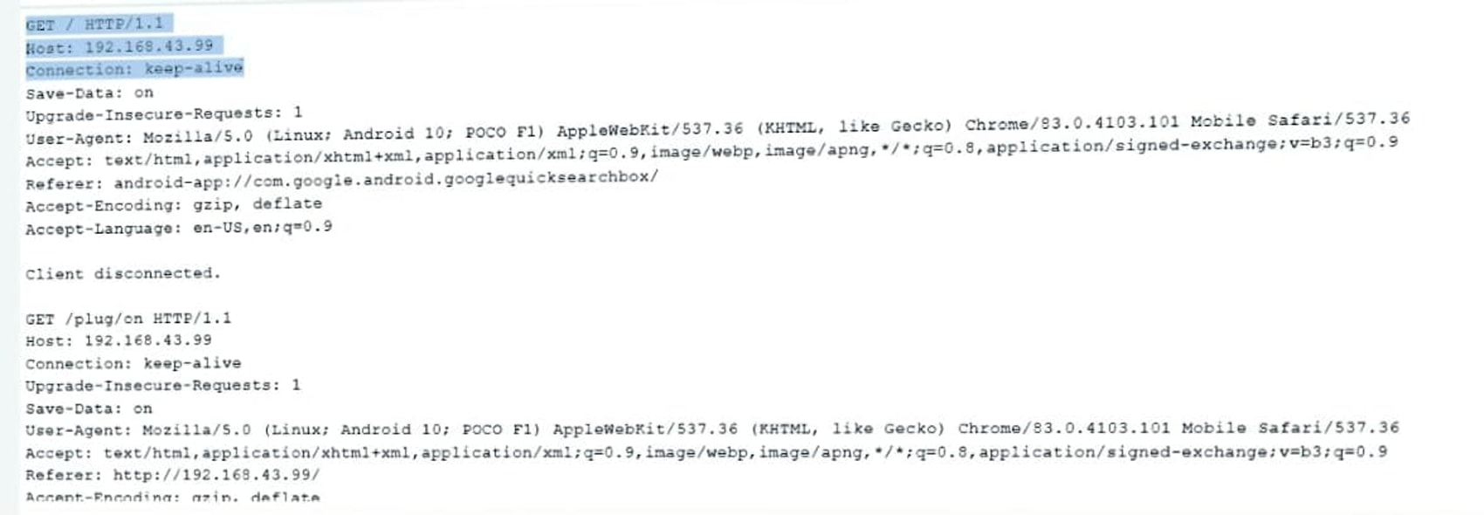
Society For Computer Technology & Research’s
Pune Institute of Computer Technology
Department of Electronics & Telecommunications Engineering
TE Mini project
AY:2022-23
Title: Smart Socket
Abstract:
The intelligent control system has developed rapidly with the development of Internet of Things technology. The Home Wi-Fi smart socket consists of three parts: hardware platform, server, and client device. We can realize control of home equipment and real time monitoring of appliances from the terminal via Wi-Fi. A smart socket is a device that connects to a home's Wi-Fi network and allows users to control their electrical devices remotely using a web server. It provides convenience and energy efficiency by enabling users to remotely turn on and off the appliances at specific times.
Problem Statement :
The main aim is to build a smart Wi-Fi socket that enables to wirelessly control AC loads through a smartphone that consumes much less power than a traditional smart socket circuit.
  Objectives of Work
  1. To explain the concept of smart sockets, their components, and how they can be used to control electrical devices remotely.
  2. To provide recommendations for selecting and using smart sockets based
  on the user's needs, preferences, and budget.
Methodology
Choose a compatible smart socket and install the smart socket.
Access the Web Server with obtained IP address
Connect the smart socket to the Web Server
Control the smart socket to the server
Record and analyze the data collected from the smart socket and device to draw conclusions about energy usage and device control.
Download and install the mobile app
Experimental Set up:
Important Results:
Smart sockets are expected to expand as more advanced technology is developed. Here are some potential areas where smart sockets could have a significant impact:
Integration with smart home systems.
Energy management and optimization.
Advanced Analytics
Internet of Things (IoT) connectivity.
Demand response programs
Important Results :
Overall, the important results of using a smart socket include increased energy efficiency, convenience
and improved safety.
References: List as per IEEE format:
1] “Smart Socket using ESP 8266” by Mr. Purushothaman B. , Mr. Prem S N. Ms.
2] “Design and Development of Smart Socket Using Internet of Things” by R. H. Goudar and S.S.Patil, International Journal of Engineering Research and Technology, Vol. 6, No. 6, pp. 147-151, 2017.
Book:
The 2023-2028 World Outlook for Smart-Connected Power Plug Socket Wi-Fi Connectivity: Prof Philip M. Parker
Conclusions:
The intelligent socket can control the power on and power off through remote control, control the time and duration of power on, prevent short circuits, overload, and leakage, and can well solve the intelligent transformation problems of some traditional electrical appliances by its monitoring.
32404 Aditi Funde
32412 Chinmay Deshmukh
32414 Disha Chinchole
Project Guide: Mrs. Jyoti Sandur

